Slide 1
Network Flow Problem
A flow network is defined as a directed graph involving a source and a sink and several others nodes connected with edges.
In network flow we calculate maximum amount of flow that the network would allow to flow from source to sink.
Ford Fulkerson Algorithm is considered as on of the famous algorithm to calculate maximum flow in the network.
Ford Fulkerson is greedy approach algorithm.

Slide 2
Ford Fulkerson Algorithm
Source is a vertex has only outward edges.
Sink is a vertex that has only inward edges.
Minimum capacity of an edge in selected path is bottle neck capacity.
Residual capacity = current capacity of edge – flow.

Slide 3
The algorithm follows:
Initialize the flow in all the edges to 0.
While there is an augmenting path between the source and the sink, add this path to the flow.
Update the residual graph.

Slide 4
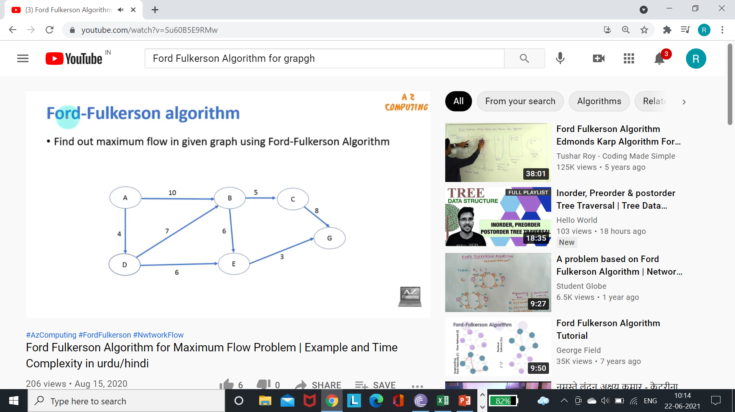

Slide 5
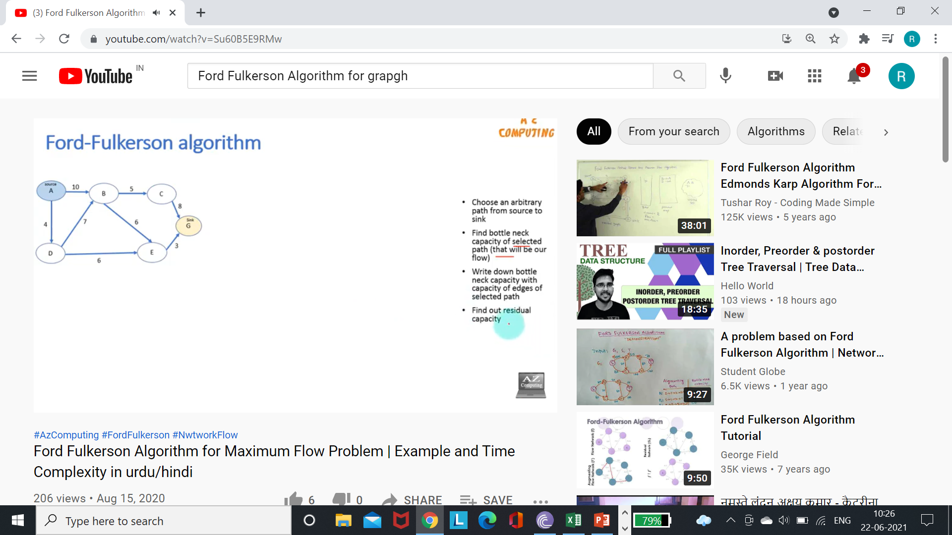

Slide 6
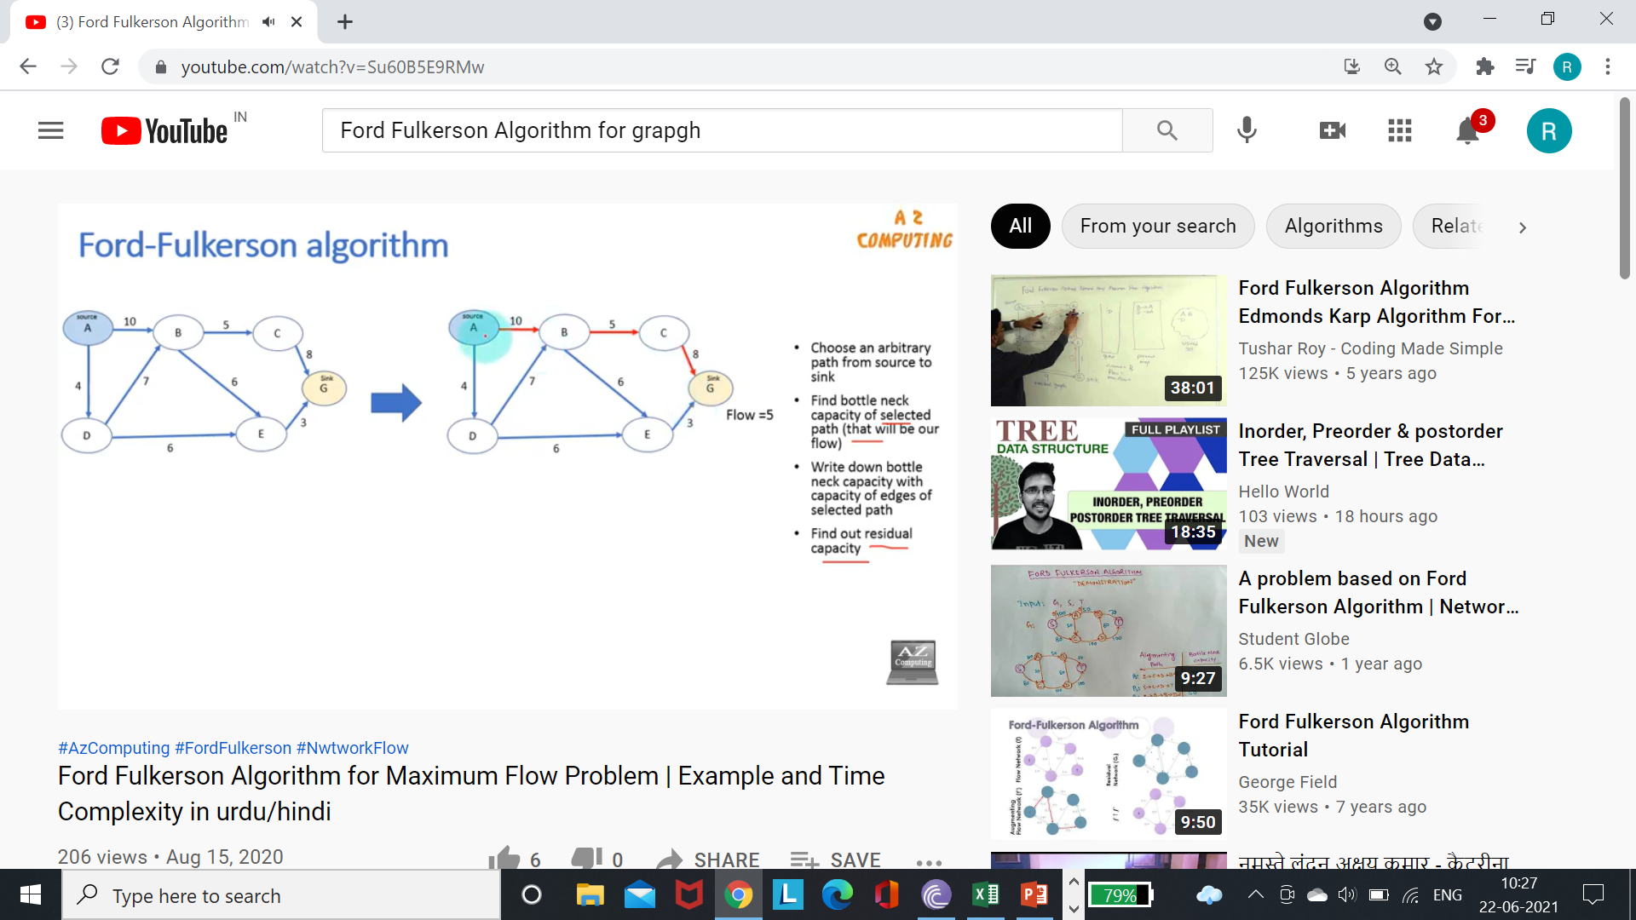

Slide 7
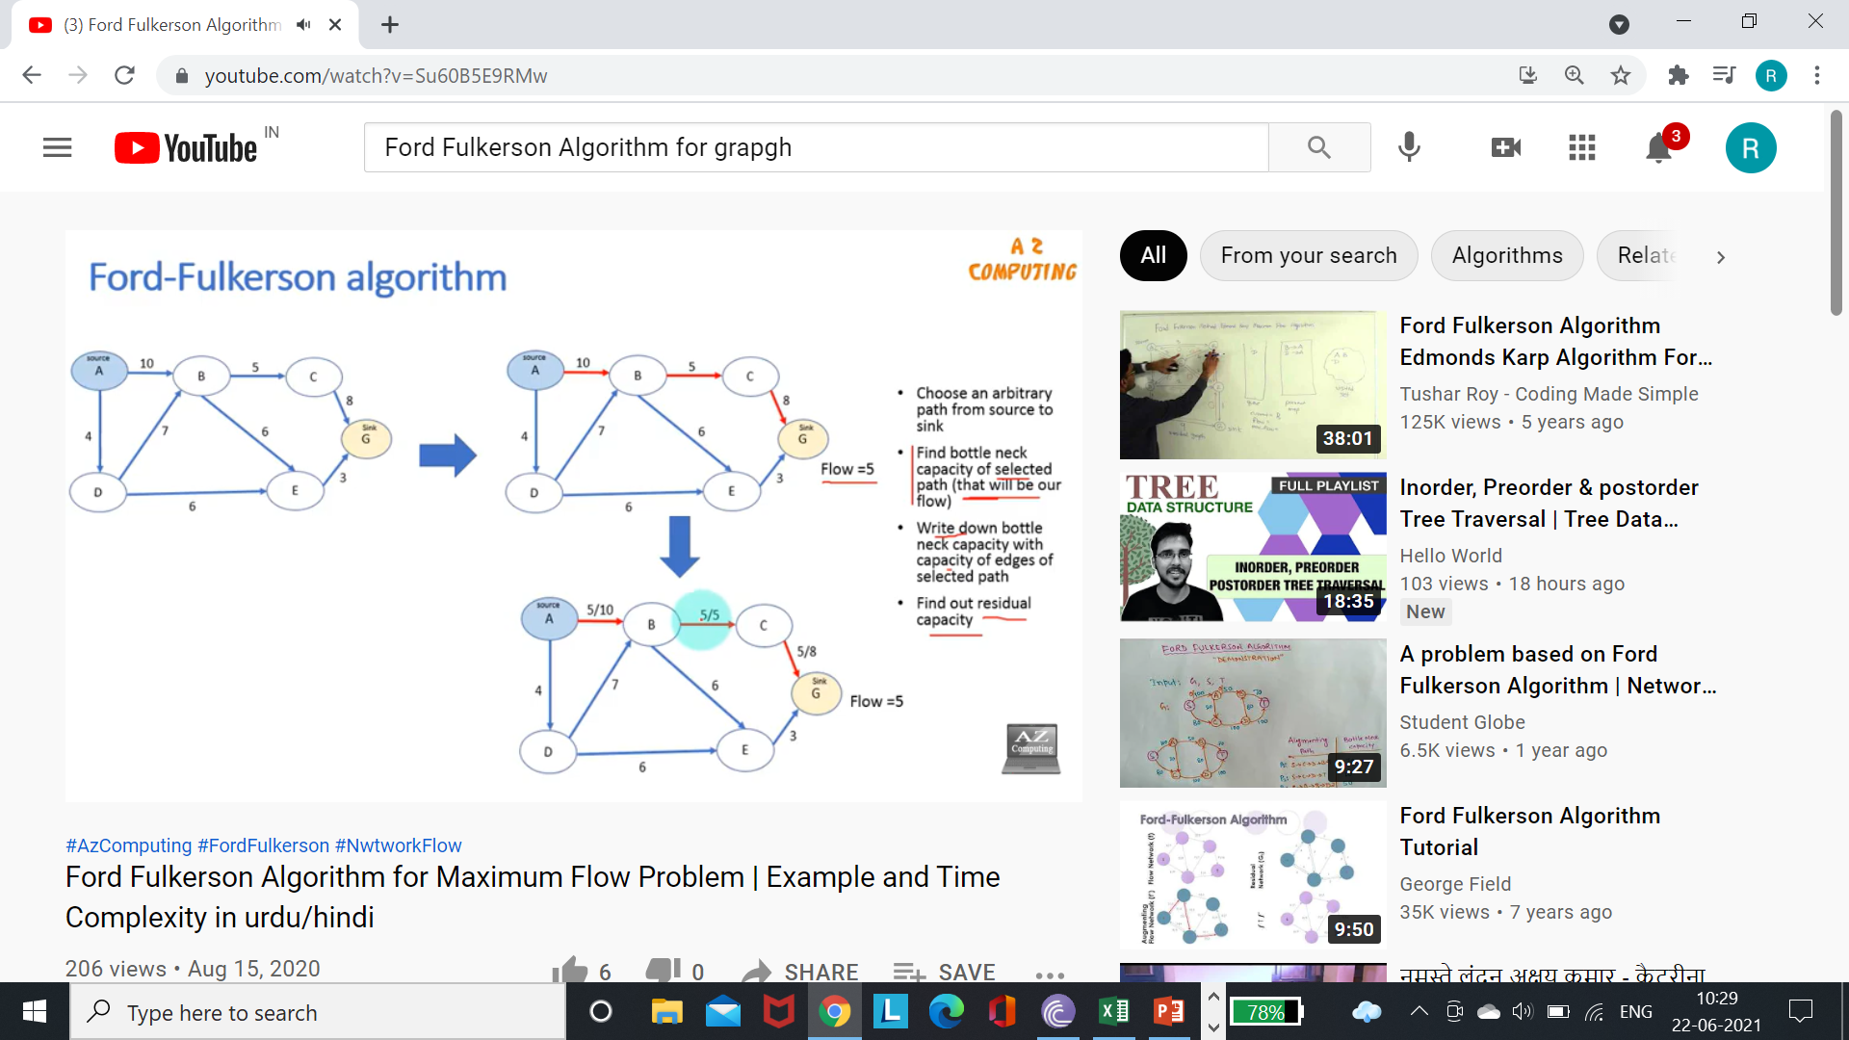

Slide 8
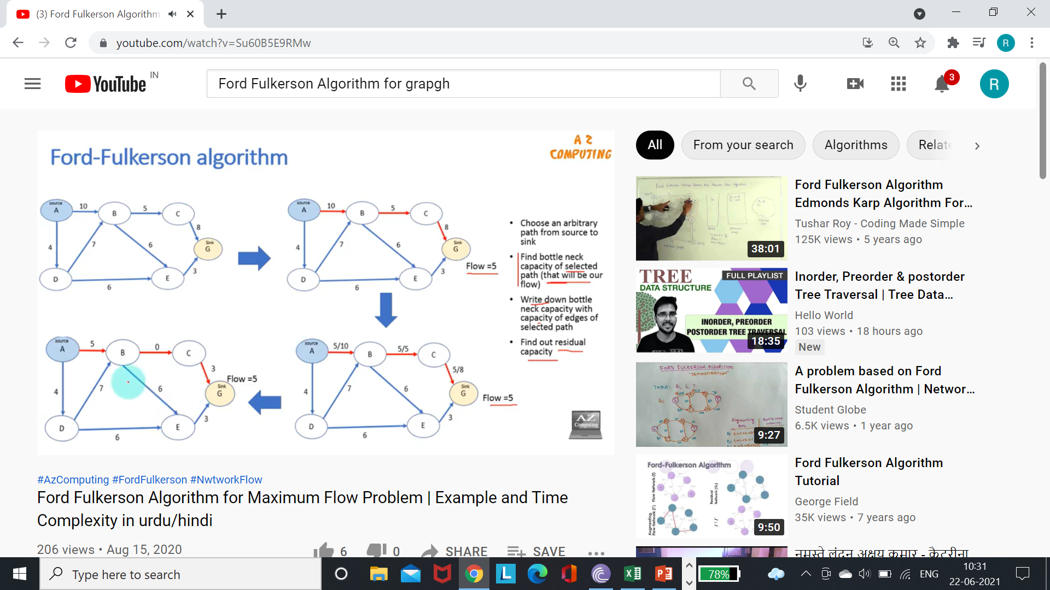

Slide 9
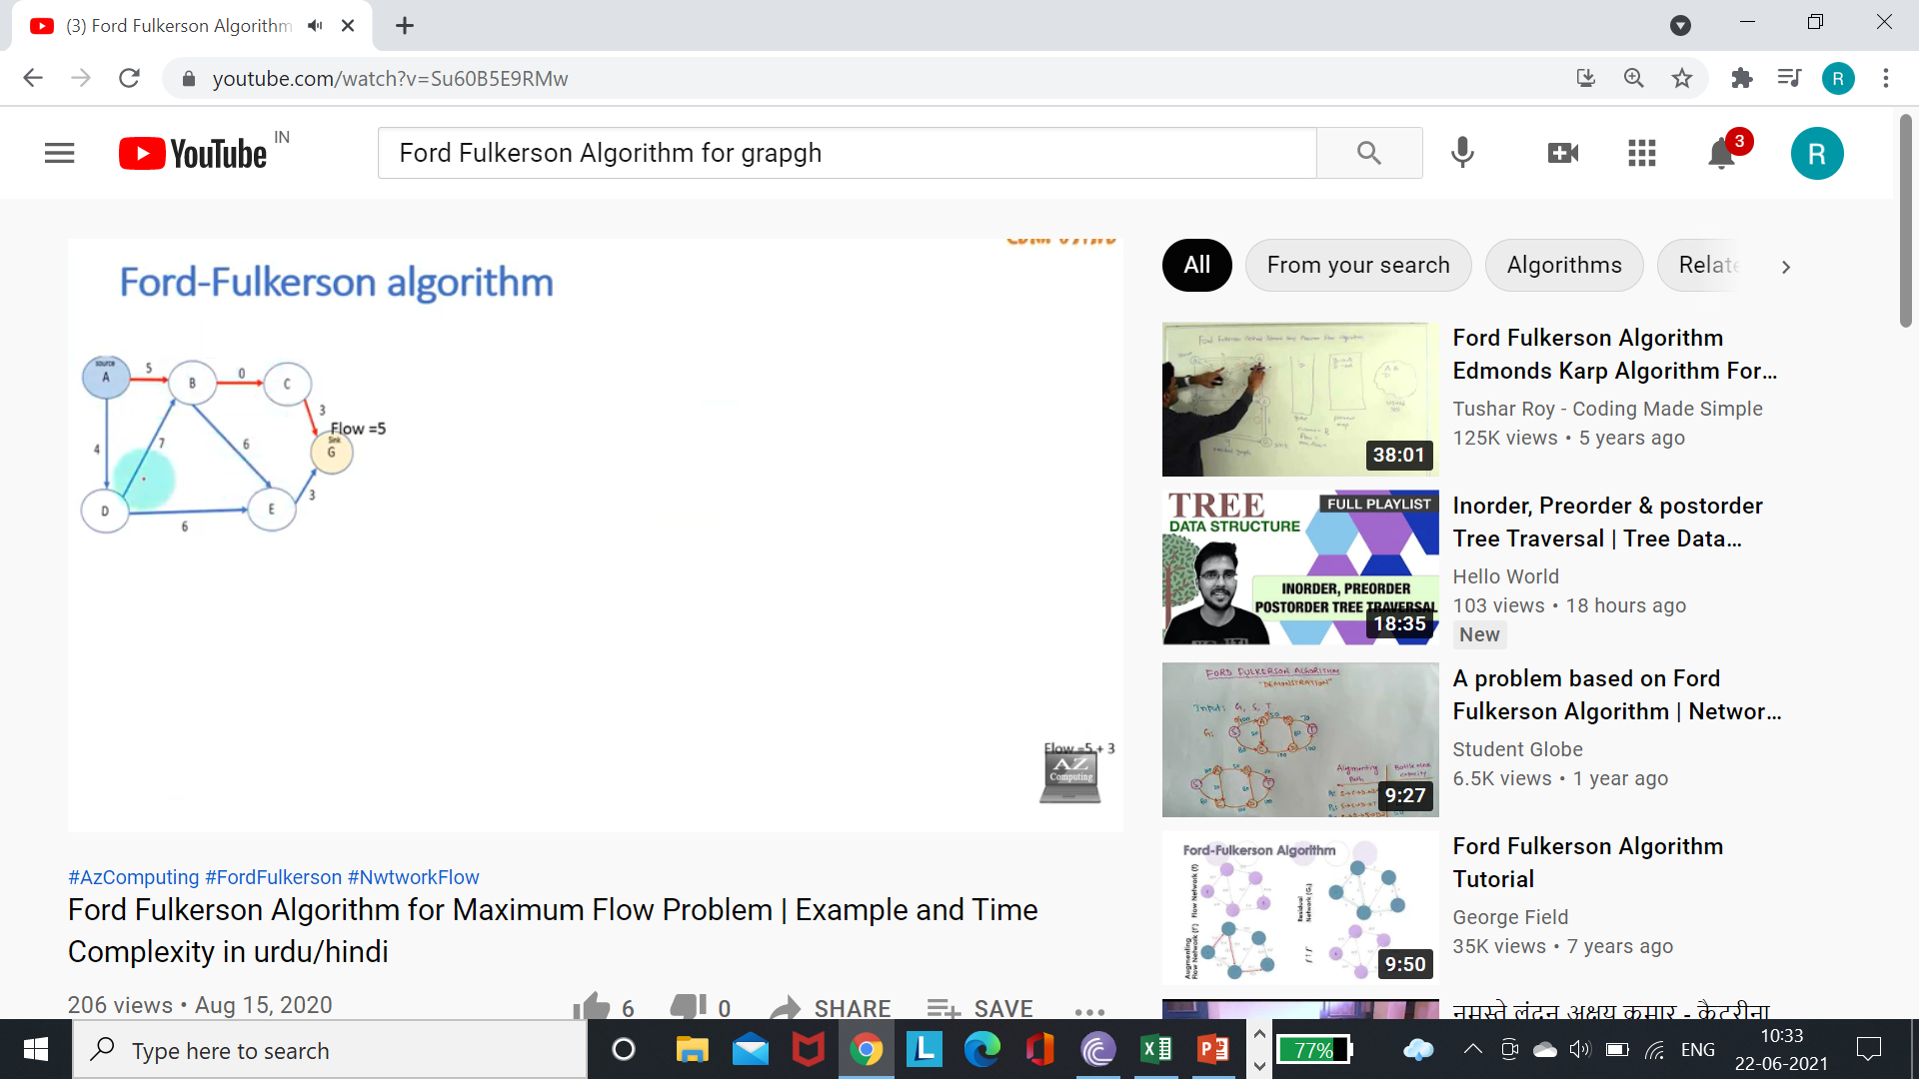

Slide 10
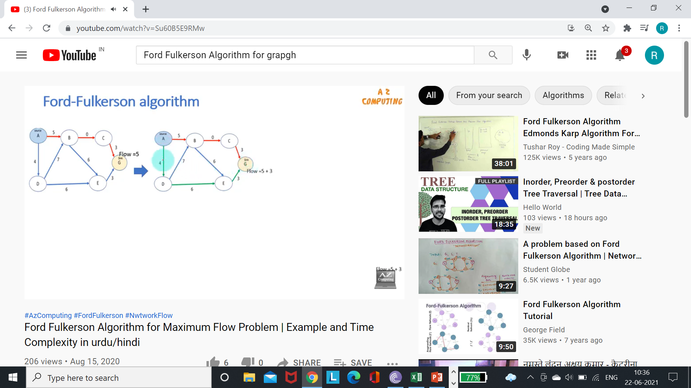

Slide 11
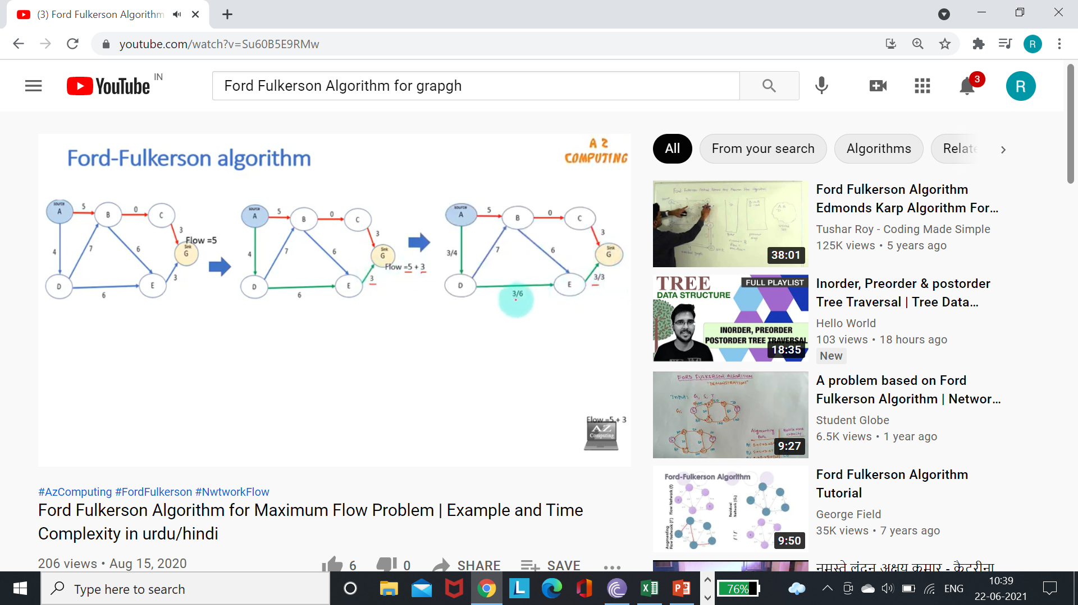

Slide 12


Slide 13
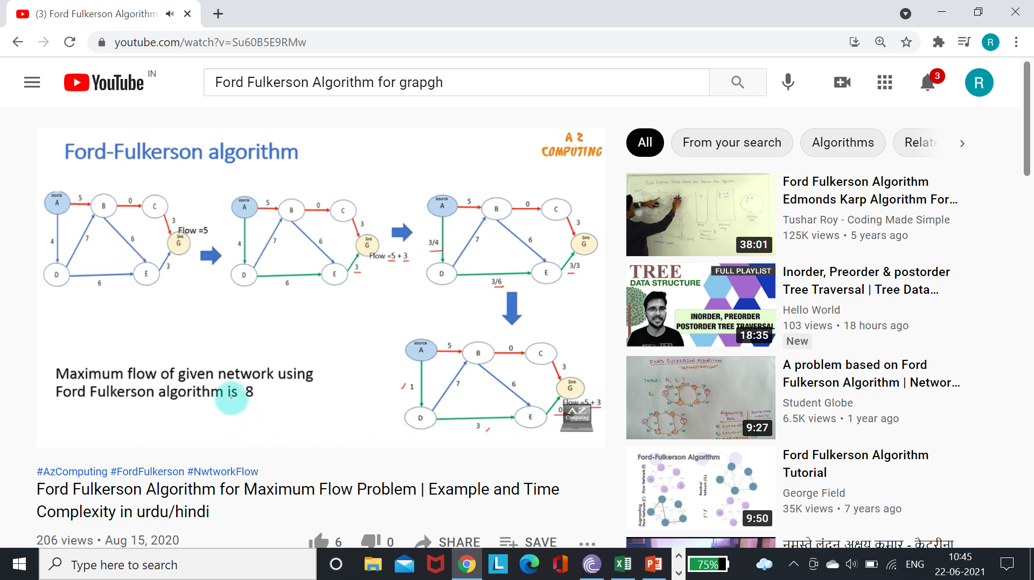

Slide 14
Time Complexity of Ford Fulkerson Algorithm
Choose an arbitrary /augmented path from source to sink.
Compute bottle neck capacity.
Residual capacity of flow.
O(E)
O(F)
O(E*F)
Time complexity of Ford Fulkerson Algorithm will be as O(E*F).

Slide 15
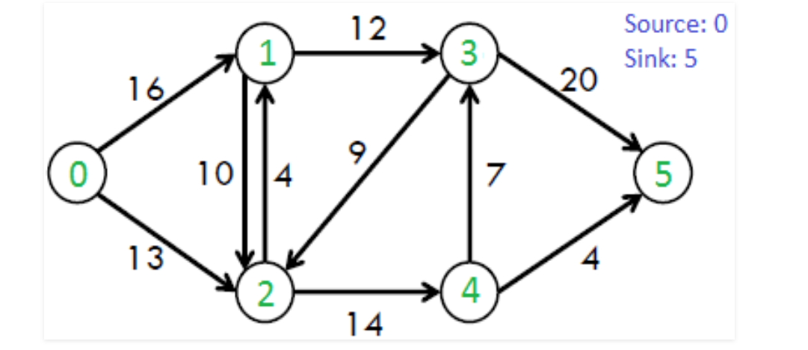
Find out maximum flow in a given graph

Slide 16
Thanks

